Slide 1

RNA-SEQ PROFILING DROSOPHILA CELLS AFTER THE DEPLETION OF A REGULATORY GENE
GROUP 6

Slide 2
Background
IN THE STUDY OF BROOKS ET AL. 2011, THE AUTHORS IDENTIFIED GENES AND PATHWAYS REGULATED BY THE PASILLA GENE (THE DROSOPHILA HOMOLOG OF THE MAMMALIAN SPLICING REGULATORS NOVA-1 AND NOVA-2 PROTEINS) USING RNA-SEQ DATA. THEY DEPLETED THE PASILLA (PS) GENE IN DROSOPHILA MELANOGASTER BY RNA INTERFERENCE (RNAI).
Total RNA was then isolated and used to prepare both single-end and paired-end RNA-Seq libraries for treated (PS depleted) and untreated samples. These libraries were sequenced to obtain RNA-Seq reads for each sample.

Slide 3
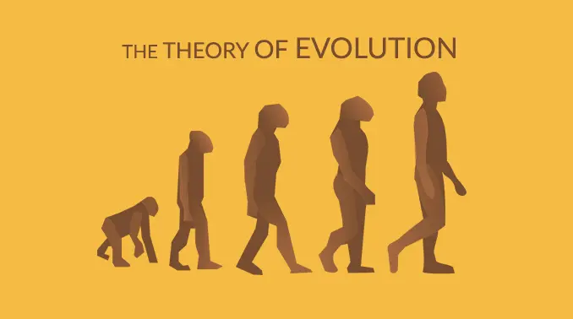
Motivation
OUR INTEREST IN THE PARTICULAR GENE WAS PIQUED WHEN WE READ THE STUDY OF BROOKS ET AL. THE PAPER EXPLORED THE POSSIBILITY OF CONSERVATION OF REGULATORY CODES AND CONCLUDED THAT THE RNA MAP OF PS AND NOVA1/2 IS HIGHLY CONSERVED BETWEEN MAMMALS AND INSECTS.

Slide 4

Datasets
4 UNTREATED SAMPLES: GSM461176, GSM461177, GSM461178, GSM461182
3 TREATED SAMPLES (PASILLA GENE DEPLETED BY RNAI): GSM461179, GSM461180, GSM461181
EACH SAMPLE CONSTITUTES A SEPARATE BIOLOGICAL REPLICATE OF THE CORRESPONDING CONDITION (TREATED OR UNTREATED). MOREOVER, TWO OF THE TREATED AND TWO OF THE UNTREATED SAMPLES ARE FROM A PAIRED-END SEQUENCING ASSAY, WHILE THE REMAINING SAMPLES ARE FROM A SINGLE-END SEQUENCING EXPERIMENT.

Slide 5


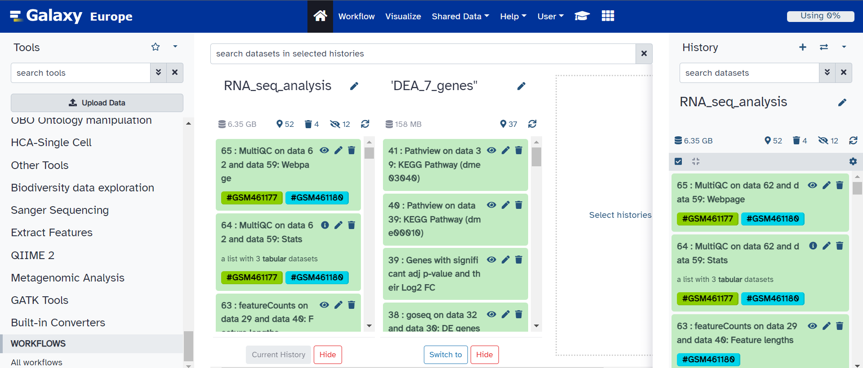

Slide 6
STEPS
1
2
3
4
5
6
Quality
Control
Mapping
Counting no. of reads
Differential Gene Expression Analysis
Functional enrichment analysis of DE genes
Conclusion

Slide 7



STEP 1 - QUALITY CONTROL
WHY CONTROL QUALITY?
Ensures accurate and reliable results
Poor quality data leads to errors and false conclusions
High-quality data necessary for downstream analysis
HOW?
FASTQC
MULTIQC
CUTADAPT
MULTIQC
Short read
data from
your current history
To aggregate the FastQC reports
Trim low quality sequences
To aggregate the Cutadapt reports

Slide 8
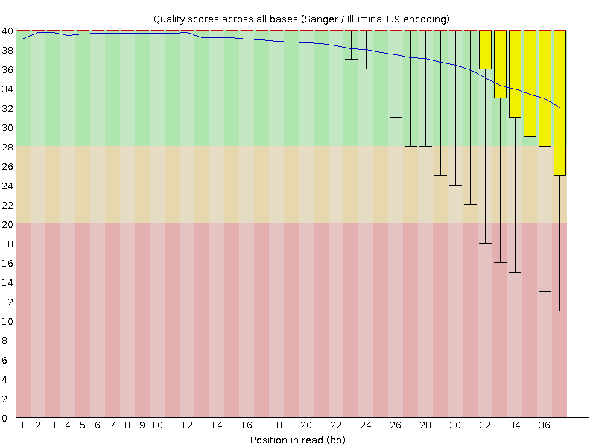
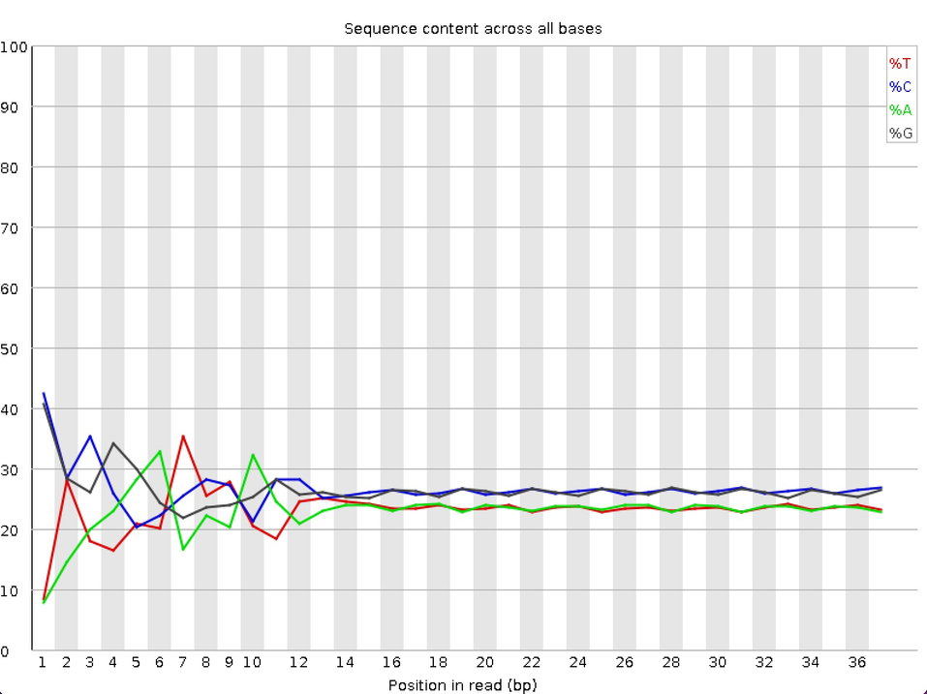
OUTPUTS:-

Slide 9
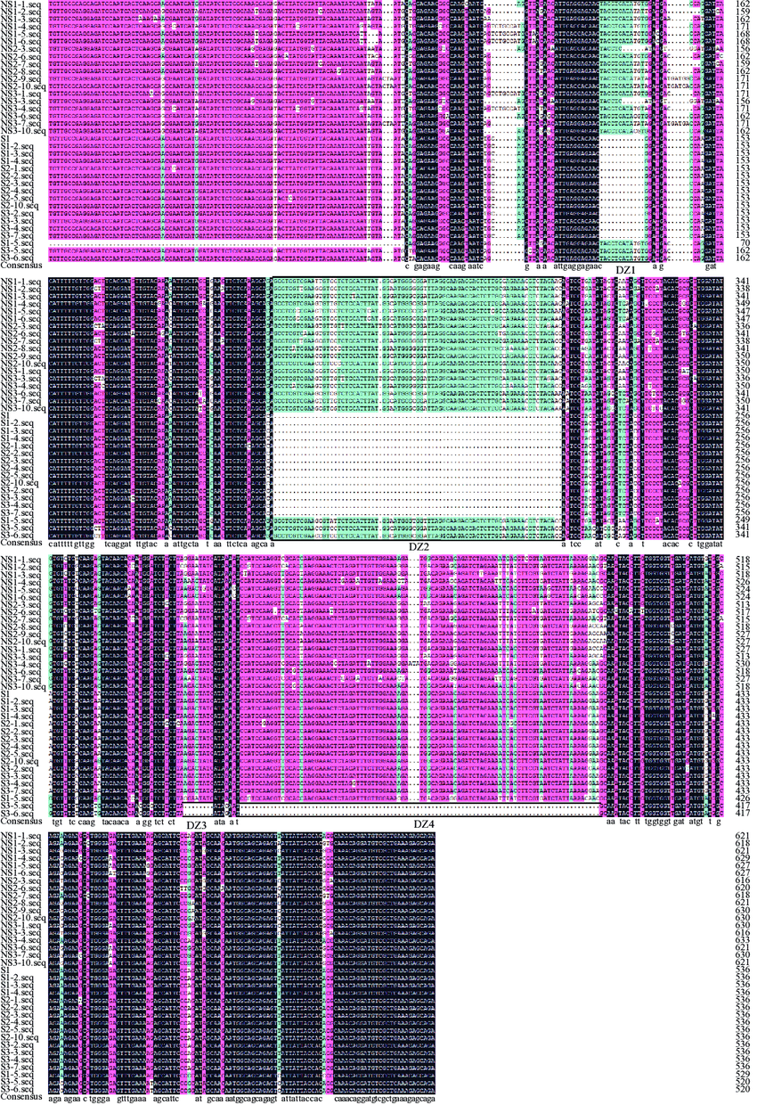


STEP 2 - MAPPING
WHAT IS MAPPING?
PROCESS OF ALIGNING THE SEQUENCE READS TO A REFERENCE GENOME
WHAT IS A REFERENCE GENOME?
A REFERENCE GENOME IS A WELL-ANNOTATED GENOME SEQUENCE THAT SERVES AS A REPRESENTATIVE EXAMPLE FOR A SPECIES OR GROUP OF RELATED SPECIES.
Preparation of reference genome
Post Processing and Analysis
Sequence Alignment
BAM/SAM File

Slide 10
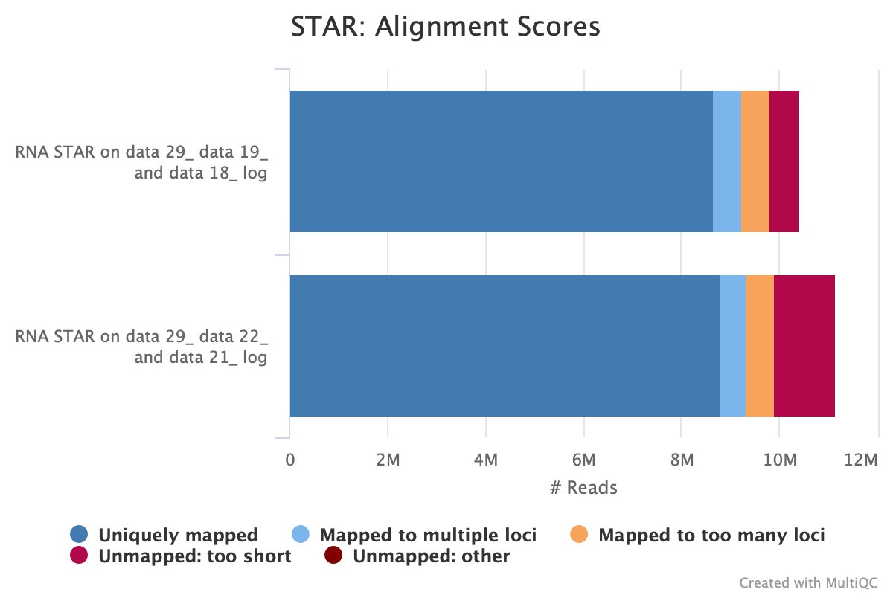

Slide 11



STEP 3 - COUNTING NUMBER OF READS
WHY?
TO COMPARE GENE EXPRESSION BETWEEN CONDITIONS, WE NEED TO QUANTIFY THE NUMBER OF READS PER GENE.
STRANDEDNESS
Strandness of the library must be determined for accurate counting of reads overlapping with genomic features.
Align reads evaluate counts in three strandness possibilities
Determine library strandness from STAR results
Use star to count reads per gene and generate a table with counts mapped

Slide 12
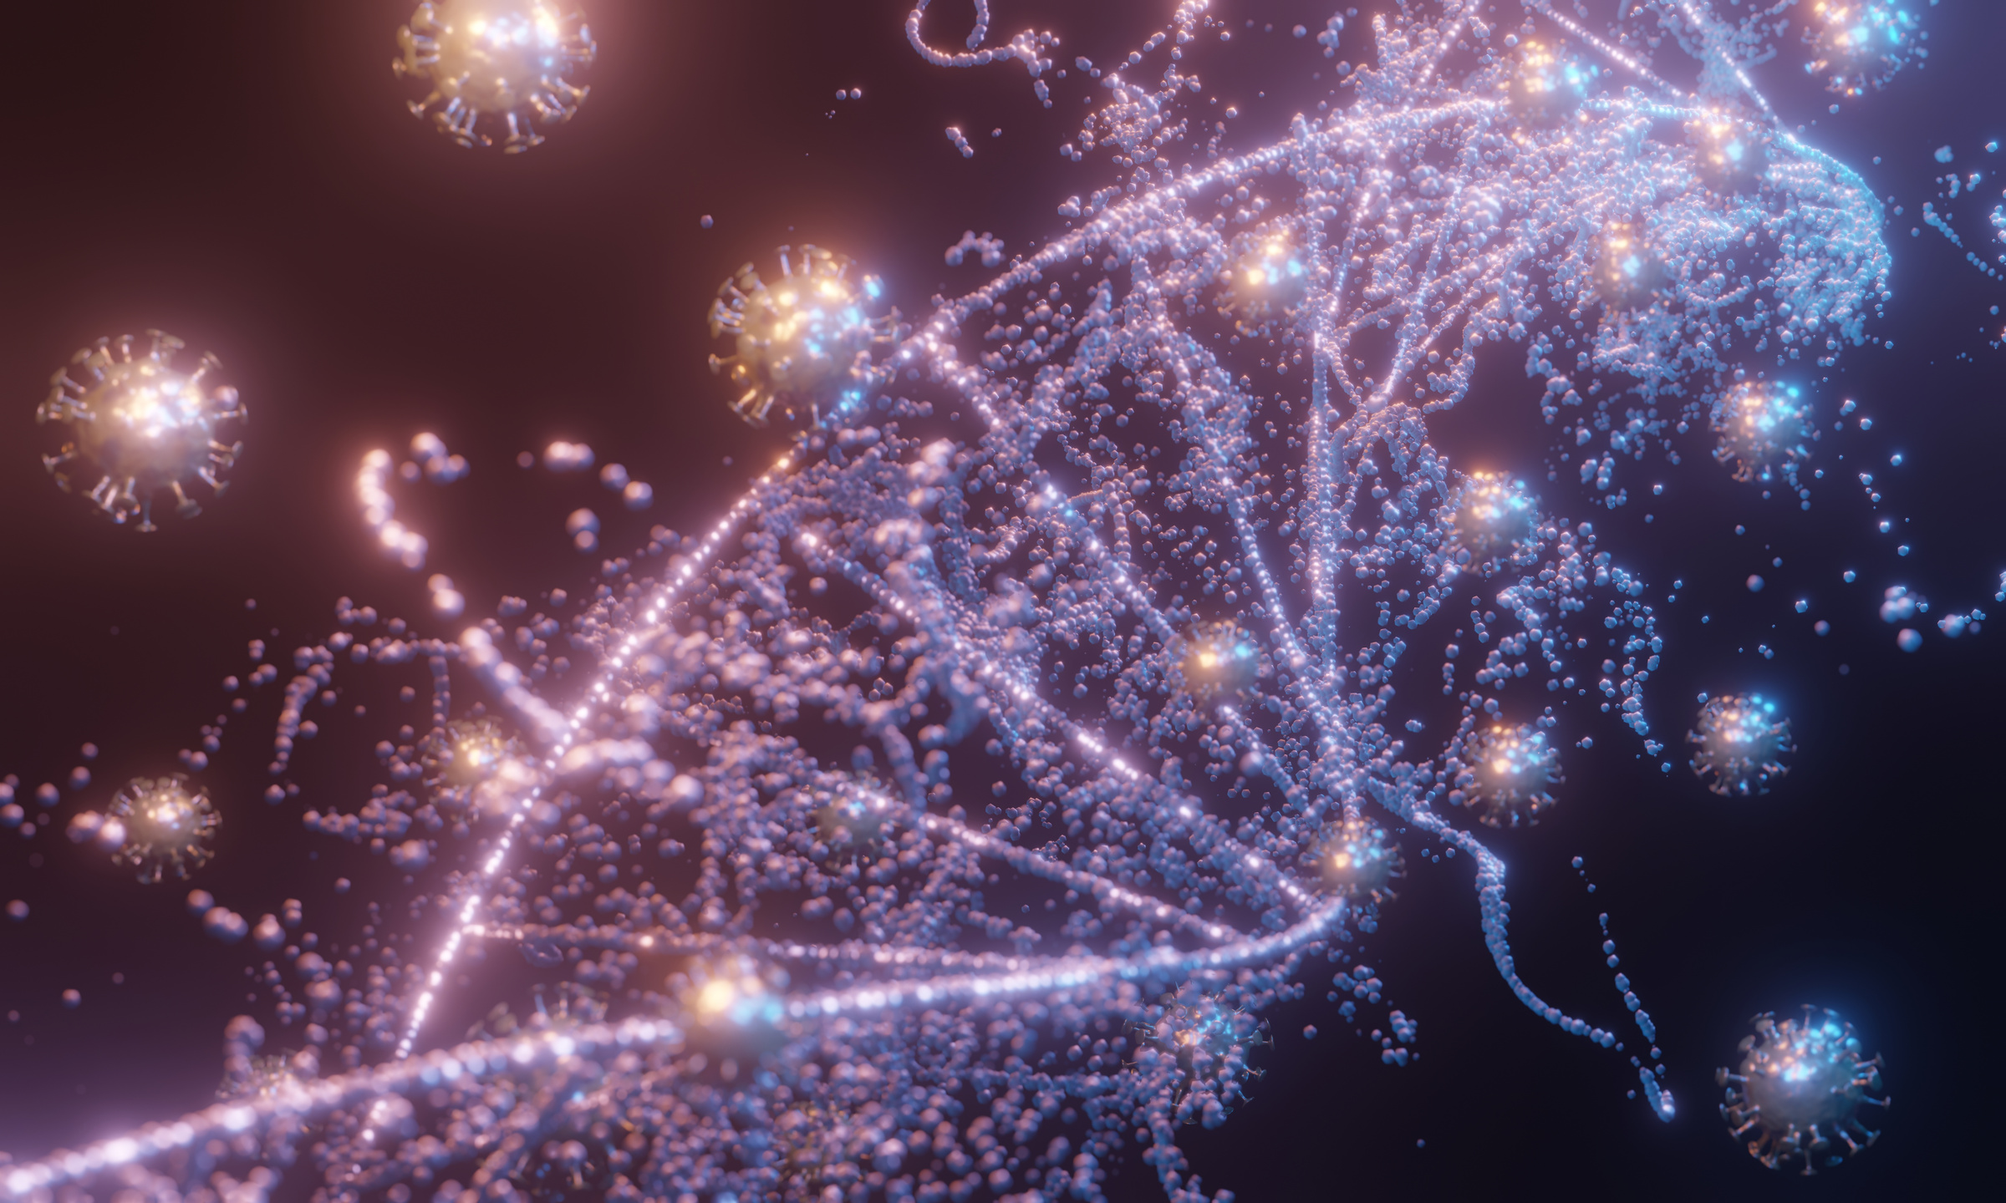
STEP 4 - DIFFERENTIAL EXPRESSION ANALYSIS
OBJECTIVES
NORMALISE DATASET AND GENERATE A SINGLE FILE WITH ALL SAMPLE DATA
PLOT PCA AND SAMPLE-TO-SAMPLE DISTANCE
GET DIFFERENTIALLY EXPRESSED GENES

Slide 13
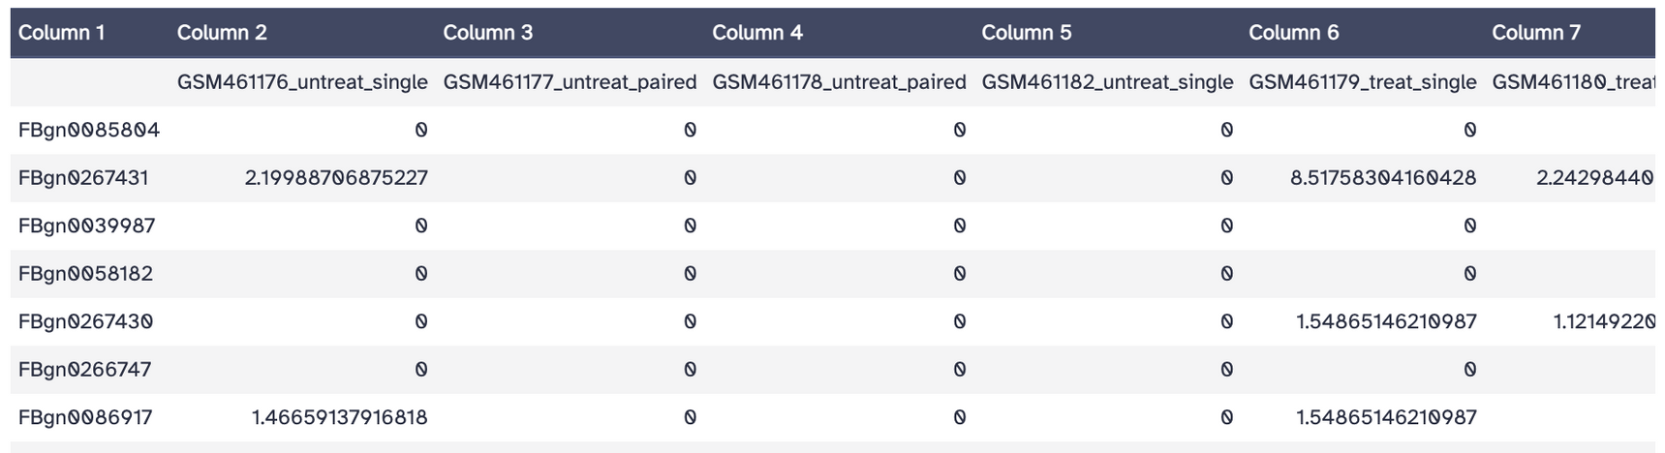
USES DEseq TO NORMALISE DATA OVER CONVENTIONAL PROCEDURES
USES SEQUENCING DEPTH AND NORMALISATION AND LIBRARY COMPOSITION
RPKM OR TPM DON'T ACCOUNT OF DIFFERENCE IN LIBRARY COMPOSITION
ABOUT 17000 GENES BETWEEN THE 7 SAMPLES

Slide 14
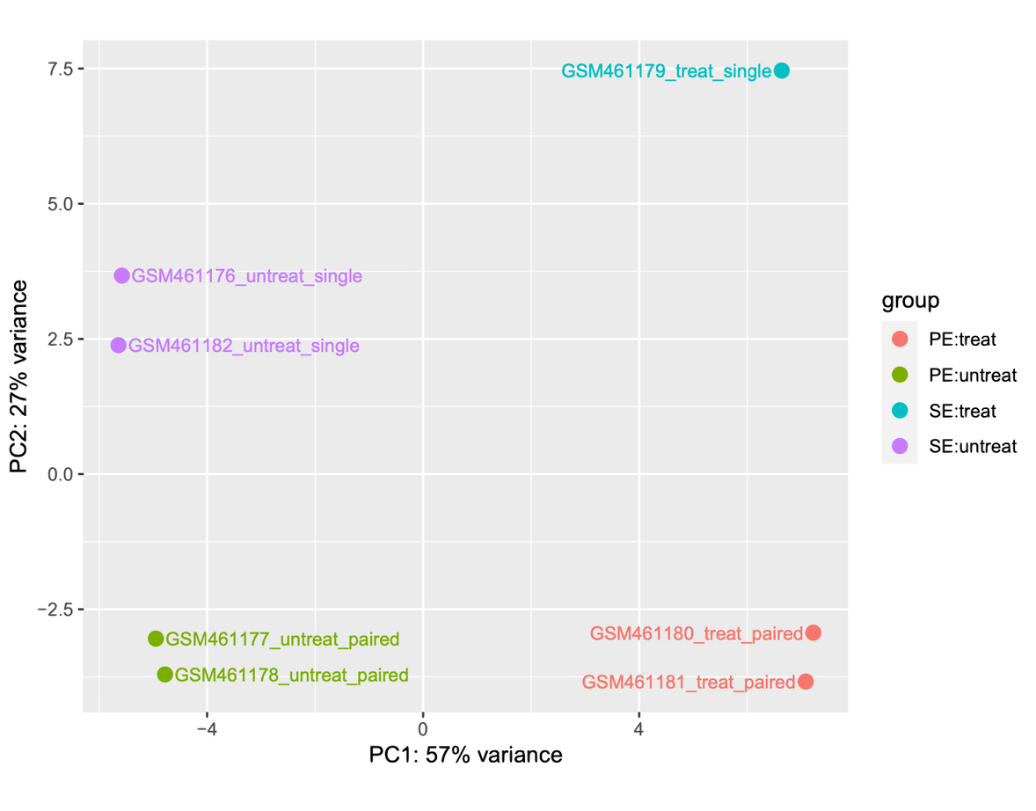
PRINCIPLE COMPONENT ANALYSIS

Slide 15
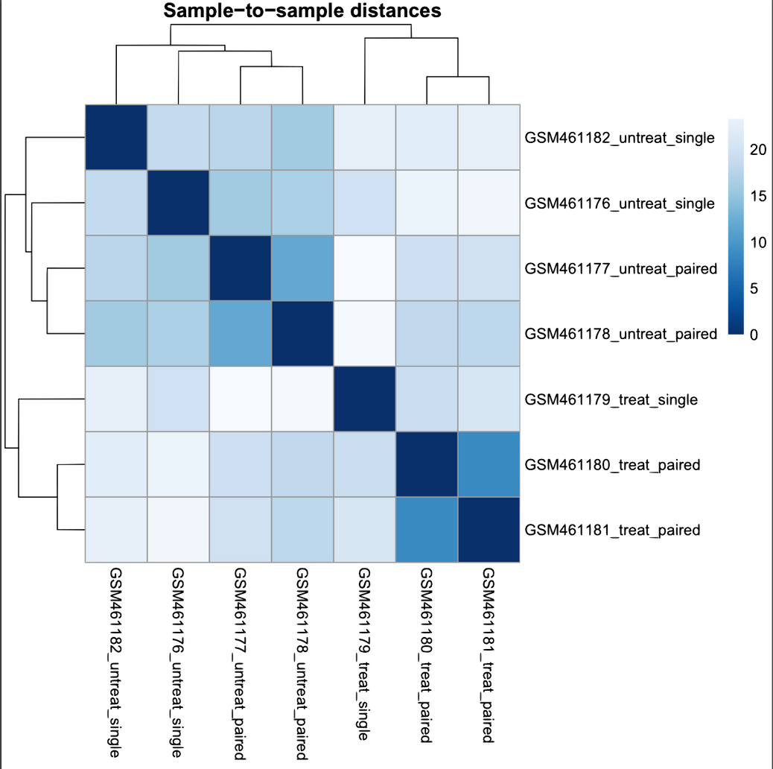
DISTANCE BETWEEN SAMPLES

Slide 16
RESULT AND ANNOTATION
PVALUE ADJUSTED FOR COMPARISON ACROSS GENES
LOG FOLD CHANGE VALUES USED TO DETERMINED EXPRESSION OF GENES
SELECT GENES BASED ON PVALUE <0.05 AND ABSOLUTE
LOG FC VALUED > 1
17,559 Genes
1,091 Genes
130 Genes
Original
p-value cutoff
p-value & logFC cutoff
ADD ATTRIBUTES TO GENES TO MAKE DATA INTUITIVE AND DIGESTIBLE

Slide 17
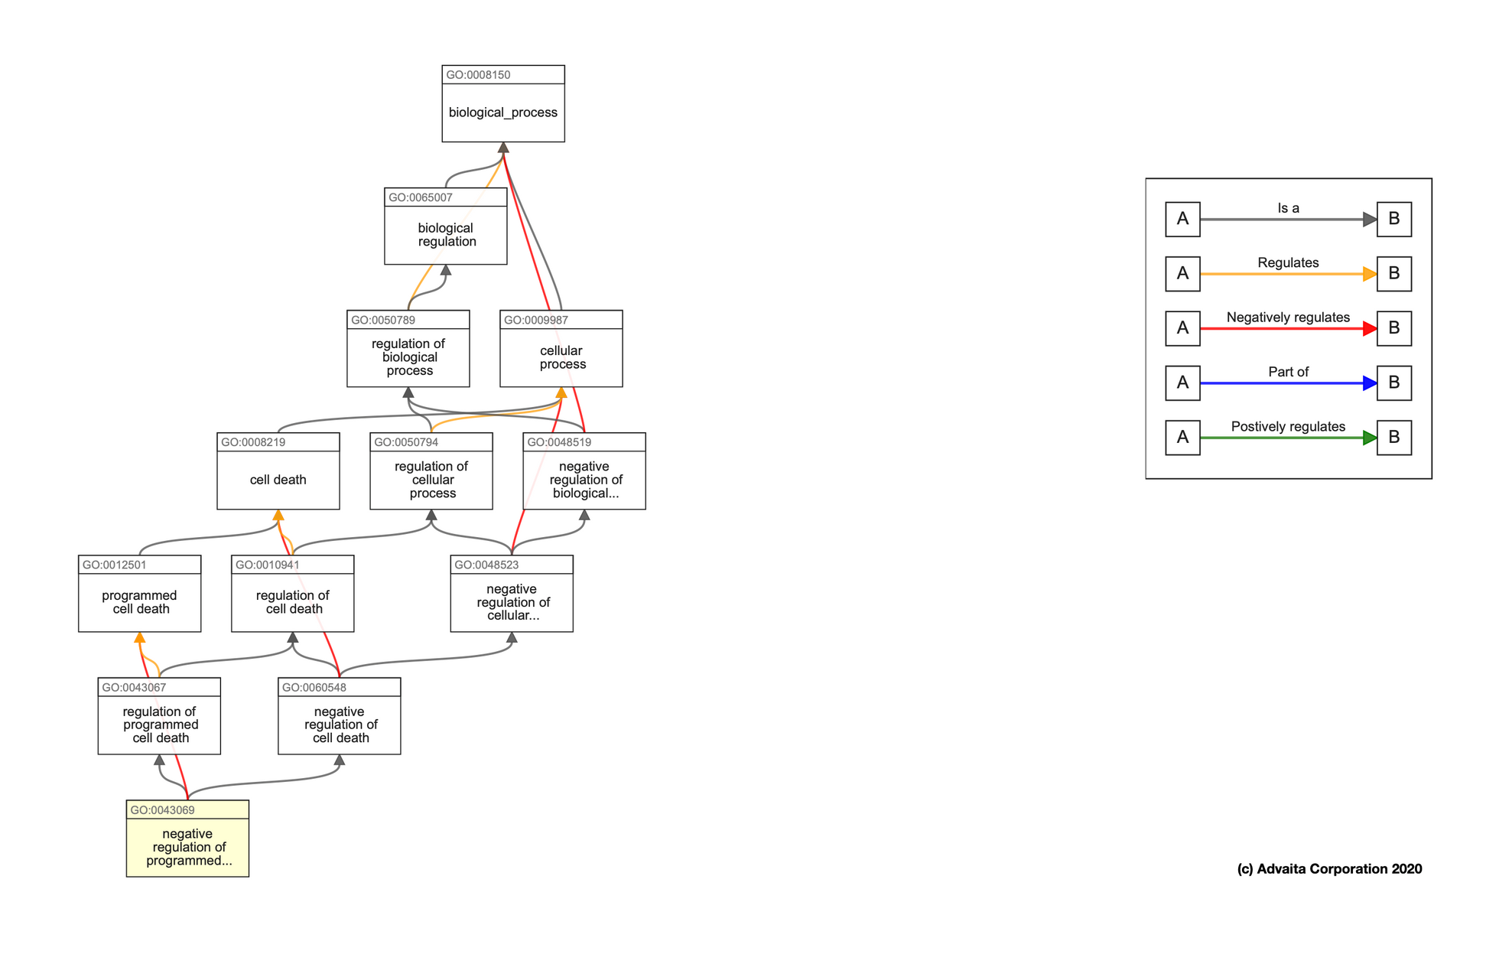
STEP 5 - FUNCTIONAL ENRICHMENT ANALYSIS OF DE GENES
DE GENE FUNCTIONAL ENRICHMENT ANALYSIS IDENTIFIES OVER-REPRESENTED BIOLOGICAL PATHWAYS, FUNCTIONAL CATEGORIES, OR GENE SETS IN A GIVEN LIST OF GENES OR PROTEINS.
GO TERMS DESCRIBE GENE FUNCTIONS IN MF, BP, AND CC CATEGORIES, PROVIDING A STANDARDIZED WAY TO DESCRIBE BIOLOGICAL PATHWAYS AND FUNCTIONS.
ENRICHMENT ANALYSIS TYPICALLY INVOLVES TWO MAJOR STEPS: GENE SET ENRICHMENT ANALYSIS AND PATHWAY VISUALIZATION/INTERPRETATION.

Slide 18
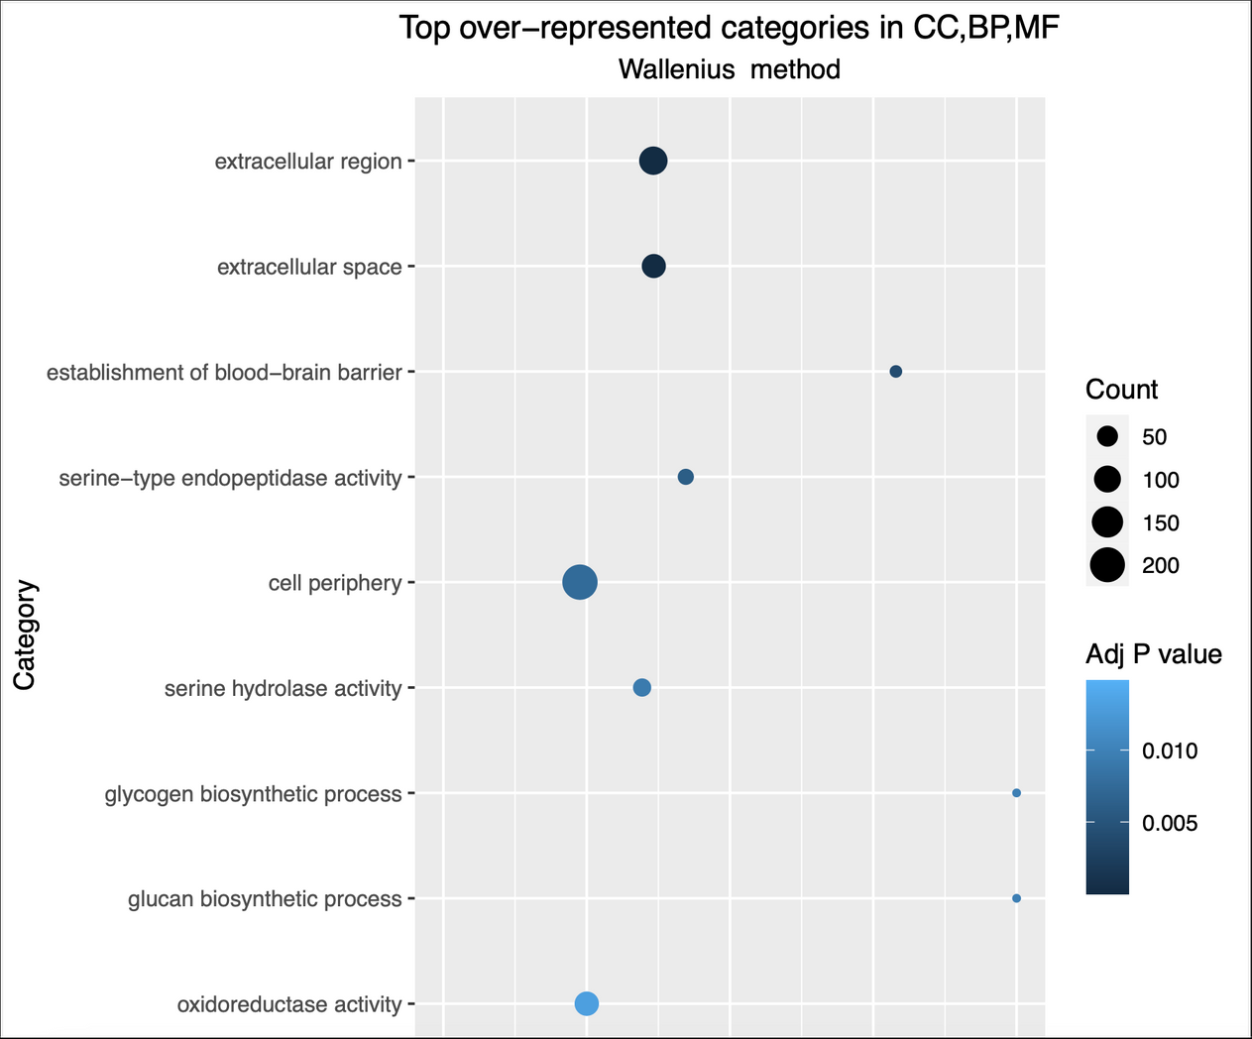
ENRICHMENT ANALYSIS RESULTS WITH WALLENIUS METHOD
THIS GRAPH SHOWS THE TOP 10 OVER-REPRESENTED CATEGORIES IN CC, BP, AND MF AS IDENTIFIED THROUGH ENRICHMENT ANALYSIS USING THE WALLENIUS METHOD. CC STANDS FOR CELLULAR COMPONENT, BP STANDS FOR BIOLOGICAL PROCESS, AND MF STANDS FOR MOLECULAR FUNCTION. THE WALLENIUS METHOD IS A STATISTICAL METHOD USED TO CORRECT FOR GENE SET SIZE BIAS IN ENRICHMENT ANALYSIS. THE PERCENTAGE OF GENES THAT ARE DIFFERENTIALLY EXPRESSED AND THE ENRICHMENT FACTOR ARE ALSO SHOWN.

Slide 19
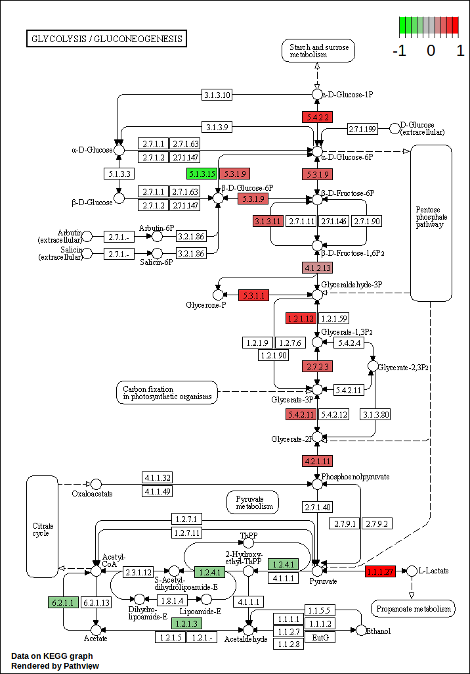
KEGG PATHWAY GRAPH
REVIEWING THE TABLE CAN BE TIME-CONSUMING AND CUMBERSOME.
TO BETTER VISUALIZE THIS INFORMATION, WE UTILIZED PATHVIEW.
PATHVIEW IS A TOOL THAT AUTOMATICALLY GENERATES PATHWAY IMAGES WITH ADDED GENE INFORMATION, SUCH AS GENE EXPRESSION DATA.

Slide 20
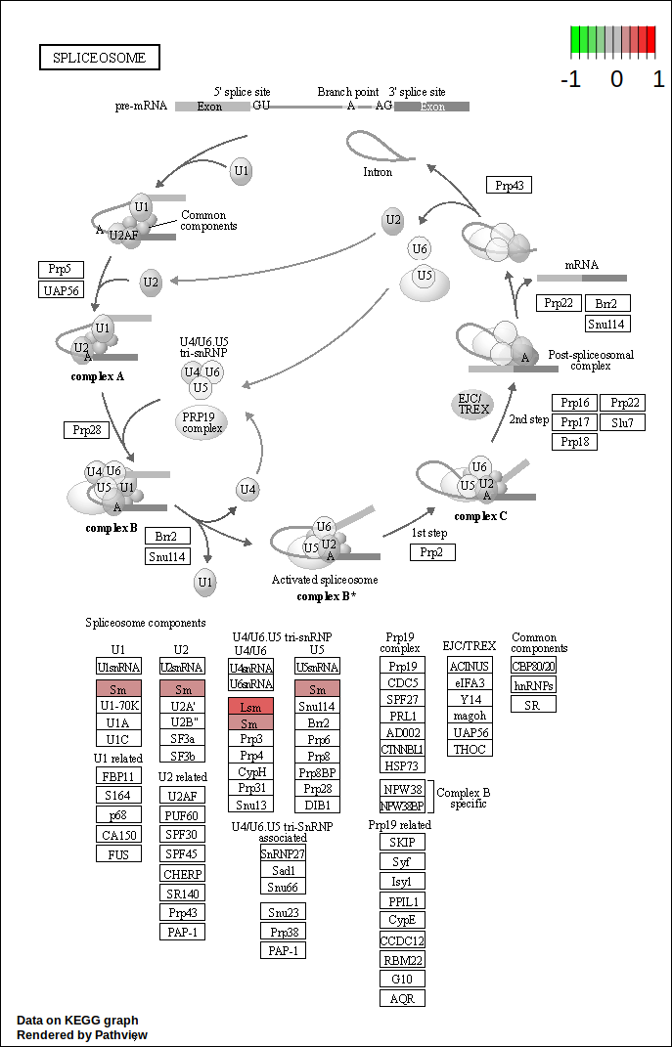
KEGG PATHWAY GRAPH
VISUALIZING THE SPLICEOSOME PATHWAY:-
KEGG PATHWAY ID: 03040
INVOLVED IN RNA PROCESSING FOR REMOVAL OF INTRONS AND SPLICING OF EXONS
NOT SIGNIFICANTLY OVER-REPRESENTED IN ANALYSIS, BUT STILL INVESTIGATED DE GENES IN PATHWAY
USED PATHVIEW TO GENERATE PLOT WITH GENE NODES COLORED BY LOG2 FOLD CHANGE
PLOT REVEALED SEVERAL GENES WITH ALTERED EXPRESSION IN PATHWAY, PROVIDING POTENTIAL INSIGHTS INTO TREATMENT'S IMPACT ON BIOLOGICAL PROCESSES.

Slide 21
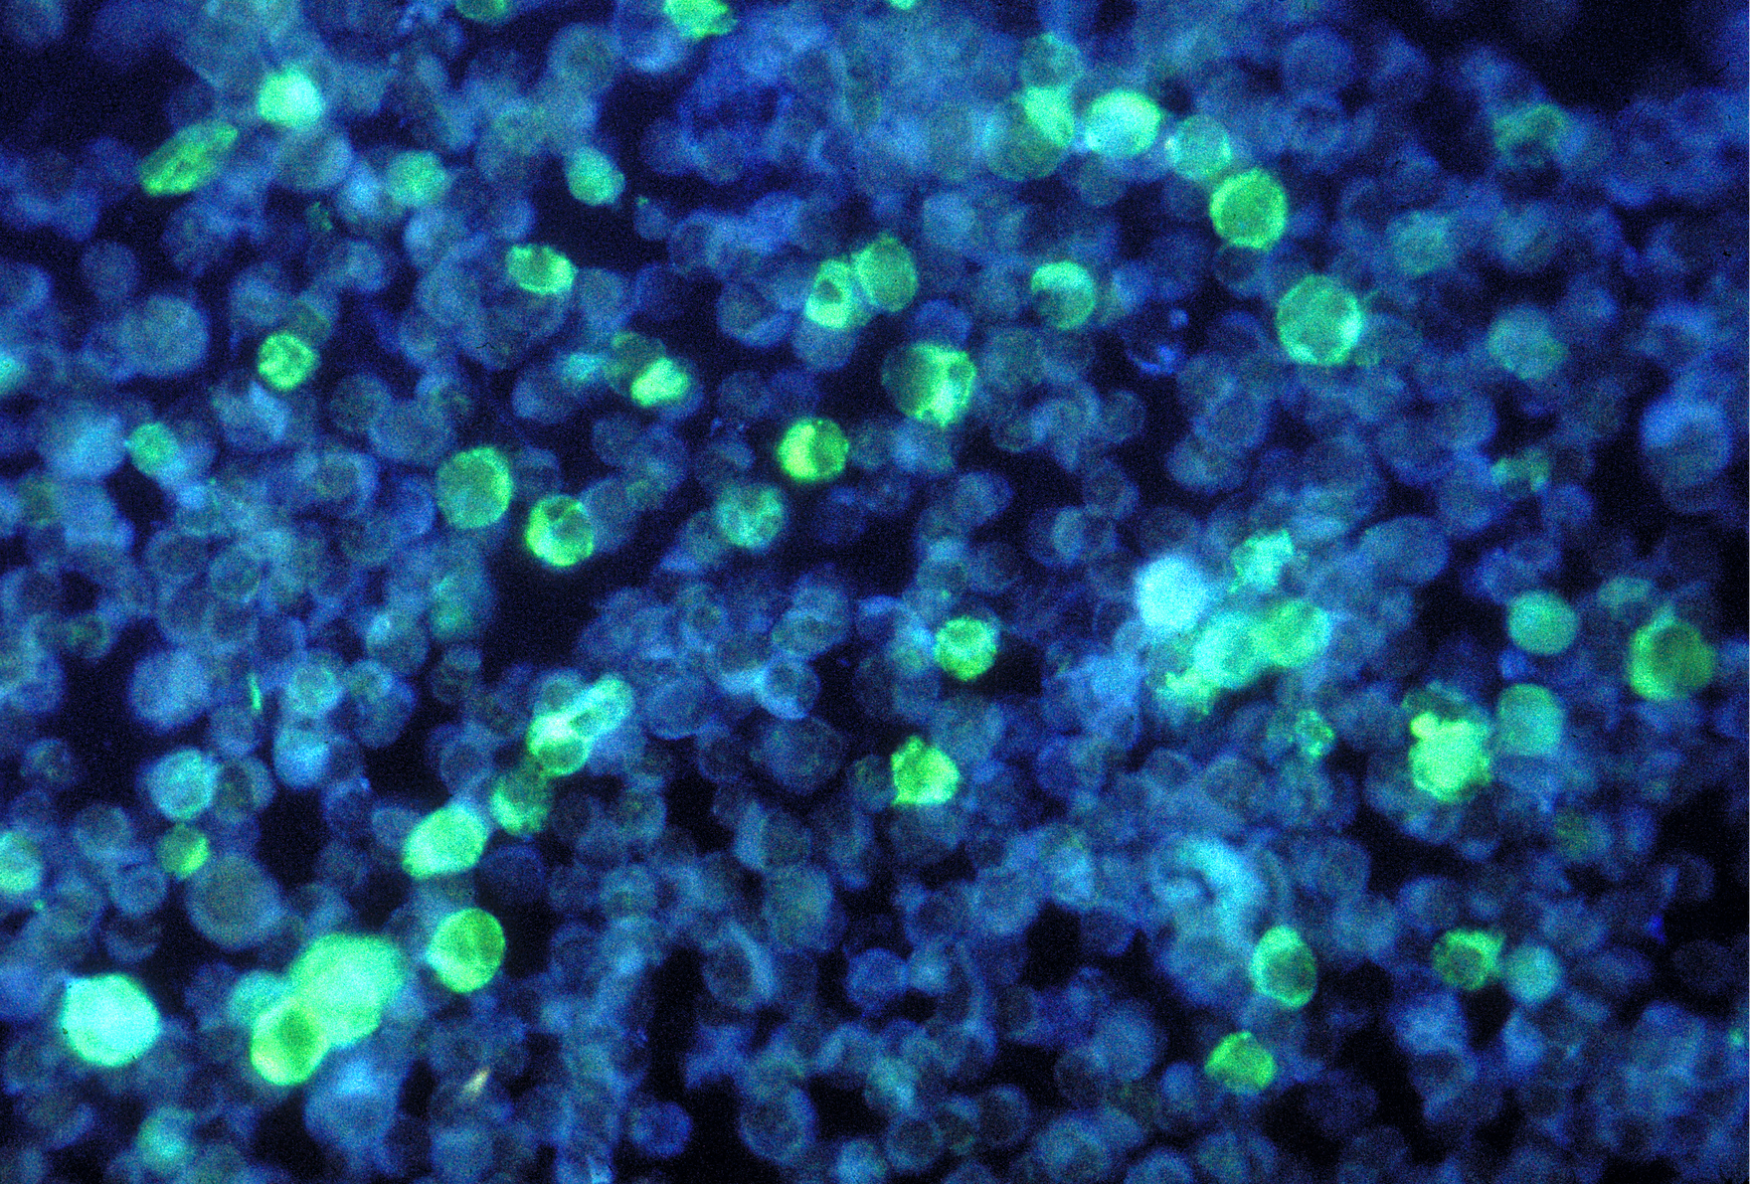
STEP 6 - CONCLUSION
DEPLETING PASILLA GENE AFFECTS THE SPLICING RATE OF GENE A AND B DIFFERENTLY.
UPREGULATION OF GENE A AND DOWNREGULATION OF GENE B SUGGEST THAT PASILLA SUPPRESSES AND PROMOTES THEIR SPLICING RATE, RESPECTIVELY.
PASILLA DEPLETION LEADS TO UNDERREPRESENTATION OF SPLICEOSOME PATHWAY GENES, IMPLYING THAT CORE SPLICEOSOME GENES ARE NOT AFFECTED.
UNDERREPRESENTATION OF THE SPLICEOSOME PATHWAY DOES NOT MEAN NO CHANGE IN SPLICING EVENTS, AND ANALYZING DIFFERENTIAL SPLICING EVENTS CAN PROVIDE BETTER INSIGHTS.
PASILLA DEPLETION SIGNIFICANTLY AFFECTS THE EXPRESSION LEVELS OF GENES INVOLVED IN THE GLYCOLYSIS PATHWAY.

Slide 22
CONTD...
THE OBSERVED DIFFERENTIAL EXPRESSION IN THE GLYCOLYSIS PATHWAY SUGGESTS THAT PASILLA DEPLETION HAS CASCADING EFFECTS ON OTHER GENES, POSSIBLY THROUGH ALTERED ALTERNATIVE SPLICING PATTERNS.
Pasilla and NOVA1/2 genes are involved in alternative splicing regulation in insects and mammals, respectively.
The RNA maps of Pasilla and NOVA1/2 are highly conserved between mammals and insects, suggesting similar splicing patterns and conserved roles in biological pathways.
The study's results can be extended to studying NOVA genes in mammals.

Slide 23
REFERENCES
Conservation of an RNA regulatory map between Drosophila and mammals. https://www.ncbi.nlm.nih.gov/pmc/articles/PMC3032923/
STAR: ultrafast universal RNA-seq aligner
https://www.ncbi.nlm.nih.gov/pmc/articles/PMC3032923/
Pathview: an R/Bioconductor package for pathway-based data integration and visualization. https://www.ncbi.nlm.nih.gov/pmc/articles/PMC3032923/
Moderated estimation of fold change and dispersion for RNA-seq data with DESeq2. https://www.ncbi.nlm.nih.gov/pmc/articles/PMC3032923/
MultiQC: summarize analysis results for multiple tools and samples in a single report. https://www.ncbi.nlm.nih.gov/pmc/articles/PMC3032923/

Slide 24
CONTRIBUTORS
AAYUSH RANJAN (2021003)
KARTIK GUPTA (2021056)
LAKSHYA GOEL (2021469)
LAKSHYA KUMAR RAIKWAR (2021470)
N NAROTAM (2021477)
PARAS DHIMAN (2021482)
SANMAY SOOD (2021095)
SIDDHARTH RAJPUT (2021102)

Slide 25

THANK YOU !

